Slide 1


Probability analysis in insurance data
By: Akhmad Taufik Ismail
Probability Course - Sekolah Data Pacmann
pacmann.io
© 2022 – Pacmann AI

Slide 2
Outline
Introduction
Dataset
Descriptive Statistic Analysis
Categorical Variables Analysis
Continuous Variables Analysis
Variables Correlation
Hypothesis Testing
Conclusion

Slide 3
Introduction
Notes:
Transisi antar outline

Slide 4
Introduction
This project dedicates to completing the final project in the probability course by Paccman. In this project, we will tell about the probabilities that may appear in insurance data. This project contains descriptive statistics, categorical variable analysis (PMF), continuous variable analysis (CDF), variable correlation analysis, and hypothesis testing. This analysis will answer several research questions.

Slide 5
Dataset
Notes:
Transisi antar outline

Slide 6
Dataset
Age - This is an integer indicating the primary beneficiary’s age (excluding those above 64 years since the government generally covers them).
Sex - This is the policyholder’s gender, either male or female.
BMI - This is the body mass index (BMI), which provides a sense of how over or under-weight a person is relative to their height. BMI is equal to weight (in kilograms) divided by height (in meters) squared. An ideal BMI is within the range of 18.5 to 24.9.
Children - This is an integer indicating the number of children/dependents covered by the insurance plan.
Smoker - This is yes or no, depending on whether the insured regularly smokes tobacco.
Region - This is the beneficiary’s place of residence in the U.S., divided into four geographic regions - northeast, southeast, southwest, or northwest.
Charges - Individual medical costs billed to health insurance.

Slide 7
Descriptive Statistics Analysis
Notes:
Transisi antar outline

Slide 8
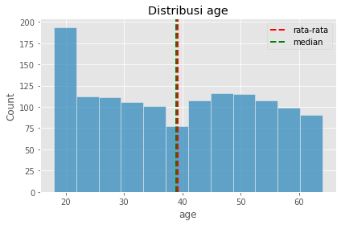
Mean of Age
Calculate the average age of all data.
This dataset shows that users average age of users range from 39-40.

Slide 9
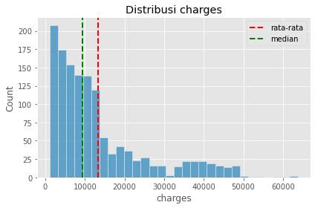
Mean of Charges
Calculate the average charges of all data.
This dataset shows that users’ average charges are 13,270.42 USD.

Slide 10
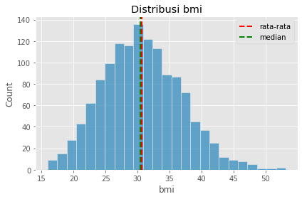
Mean of BMI
Calculate the average BMI of all data.
This dataset shows that users’ average Body Mass Index (BMI) is 30.66.

Slide 11
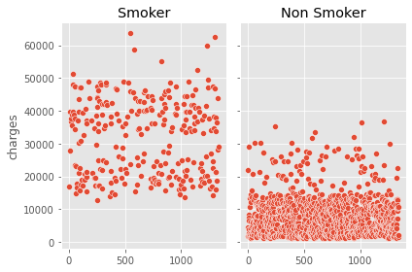
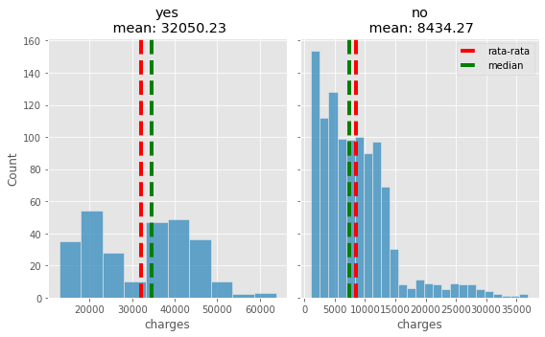
Variance of the data charges of smokers and non-smokers
First, perform the separation of data between smokers and non-smokers. After that, plot the smoker data and the non-smoker data
The charge variance of the smoking user is 133,207,311.21;
The charge variance of the non-smoking user is 35.925,420.50.

Slide 12
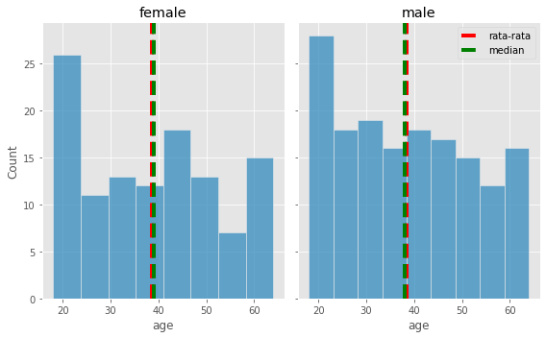
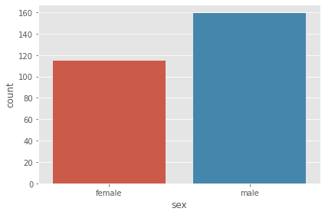
Mean of age females and males who smoke
Calculate the average age of users who smoke by gender.
The average age of the female is 38-39;
The average age of the male is 38-39

Slide 13
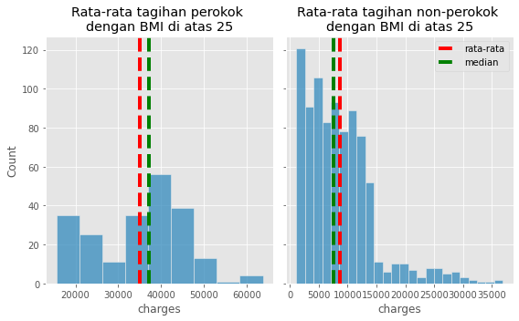
Average health charge of smokers whose BMI is above 25 and non-smokers whose BMI is above 25?
Calculate the average charges of smokers and non-smoker users based on high BMI.
The average smoker with a BMI above 25 is 35,116.91 USD
The average non-smoker with BMI above 25 is 8,629.58 USD

Slide 14
Analysis
The dataset is from 1338 people with an average age of 39-40 years. Their average BMI value is 30.6; this shows that the average person has an overweight BMI, although the value is not far from the normal range (19-25). Their average charge is 13,270.42 USD, while the median charge is around 10,000 USD, indicating skewed data.
The charges variance between smoking users and non-smoking users have different conflicts. The mean and median values for smoking users are not very different, so the average value is reliable. The same goes for non-smokers.
The charges of smokers with high BMI values have similar average and median values, so the mean value is reliable. Meanwhile, charges for non-smokers with high BMI values have different mean and median values, so the median value is reliable.
The average charge for a smoker with a high BMI is 35116.91 USD.
The median charge of non-smoker users with a high BMI is 7580.89 USD.

Slide 15
Categorical Variables Analysis
Notes:
Transisi antar outline

Slide 16
Proportion of females and males
Calculate charges probability by gender.
The probability of the charge in males is 0.505
The probability of the charge in females is 0.495

Slide 17
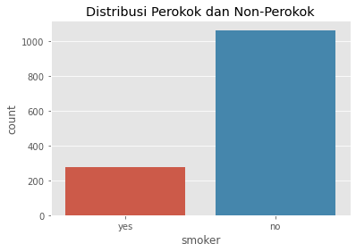
Proportion of smokers and non smokers
Calculate charges probability by smokers.
It turns out that the distribution of data on smokers and non-smokers is unbalanced, so the probability of each data will be:
The probability of smokers is 0.205
The probability of non-smokers is 0.795.

Slide 18
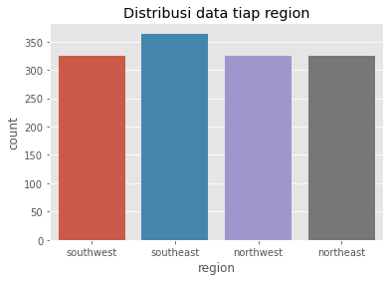
Proporsion of charges in each region
Calculate charges probability by region.
Because regions have a distribution uniform, each region’s probability value will be similar. In theory, the probability value of each region’s bill is 0.25. However, the probability value of the actual bill of each region:
The probability in the Southwest Region is 0.243;
The probability in the Southeast Region is 0.272;
The probability in the Northwest Region is 0.243;
The probability in the Northeast Region is 0.242.

Slide 19
Probability that a person is a female, given she is a smoker
Calculate the conditional probability that the person is a female, given that she is a smoker.
The probability that a person is a female, given that she is a smoker, is 0.420. It means that if someone comes to an event full of smokers, the probability of us finding a female is 42%.

Slide 20
Probability that a person is a male, given he is a smoker
Calculate the conditional probability that the person is a male, given that he is a smoker.
The probability that a person is a male, given that he is a smoker, is 0.580. It means that if someone comes to an event full of smokers, the probability of us finding a male is 58%.

Slide 21
Analysis
The dataset consists of 662 women and 676 men. The probability of billing for women is 0.495, while the probability of being billed for men is 0.505. So, men have a slightly higher probability of paying bills than women. If we meet someone randomly, they will be a woman at 49.5% and a man at 50.5%.
The dataset consists of 274 smokers and 1064 non-smokers. The probability of billing for smokers is 0.205, while the probability of charges for non-smokers is 0.795. If we meet someone randomly, they will be a smoker at 20.5%.
Based on this explanation, we can find that the conditional probability that a woman is known to be a smoker is 0.420. It means that if someone comes to an event full of smokers (assuming everyone there smokes), the probability of us finding a female is 42%. The probability of us finding a male is 58%

Slide 22
Continuous Variables Analysis
Notes:
Transisi antar outline

Slide 23
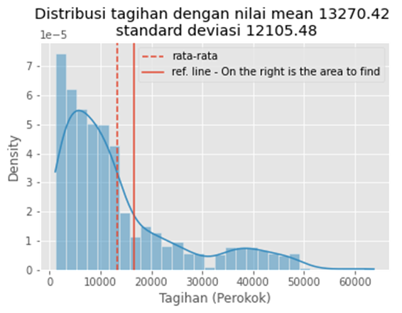
Probability of someone having high charges
First, look for the average value of the bill as well as find the standard deviation value.
The probability of someone having high charges (16,700 USD) is 38.85%.

Slide 24
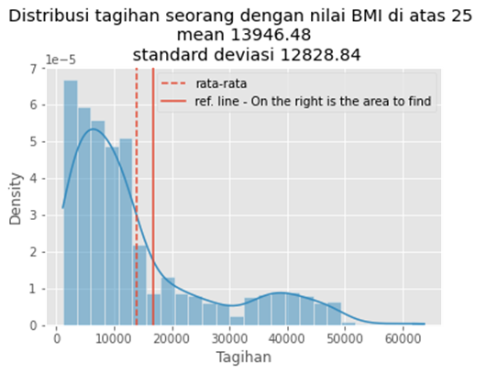
High BMI vs Normal BMI
Which one is more probable, Someone with a BMI above 25 will get high charges?
First, look for the average value of the bill as well as find the standard deviation value.
The probability of someone with a BMI above 25 having high charges (16,700 USD) is 41.50%.

Slide 25
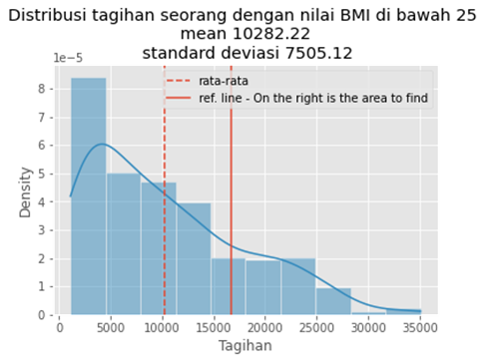
High BMI vs Normal BMI
Which one is more probable? Someone with a BMI below 25 will get high charges
First, look for the average value of the bill as well as find the standard deviation value.
The probability of someone with a BMI below 25 having high charges (16,700 USD) is 19.62%.

Slide 26
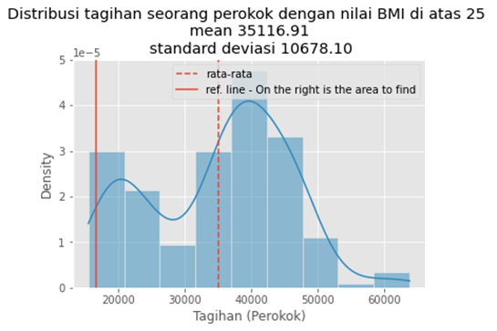
Smokers vs Non-smokers
Which one is more probable? Someone who smokes with BMI above 25 will get high charges, or
First, look for the average value of the bill as well as find the standard deviation value.
The probability of someone who smokes with a BMI above 25 having high charges (16,700 USD) is 95.77%.

Slide 27
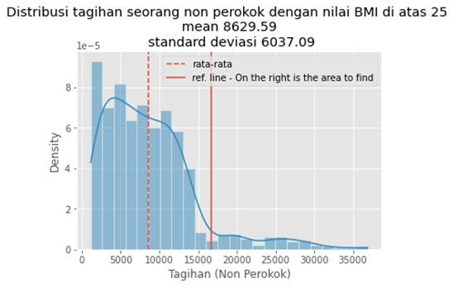
Smokers vs Non-smokers
Which one is more probable? Someone whom non-smokers with BMI above 25 will get high charges.
First, look for the average value of the bill as well as find the standard deviation value.
The probability of someone who is a non-smoker with a BMI above 25 having high charges (16,700 USD) is 9.06%.

Slide 28
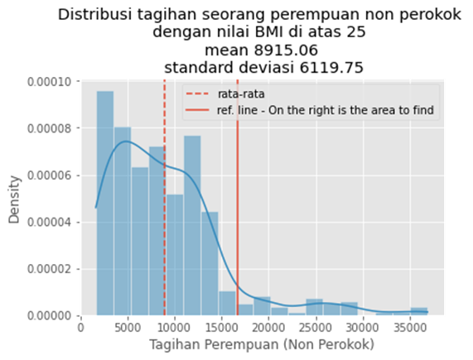
Female vs Male
Which one is more probable? Non-smokers female with a BMI above 25 will get high charges, or
First, look for the average value of the bill as well as find the standard deviation value.
The probability of non-smokers females with a BMI above 25 having high charges (16,700 USD) is 10.17%.

Slide 29
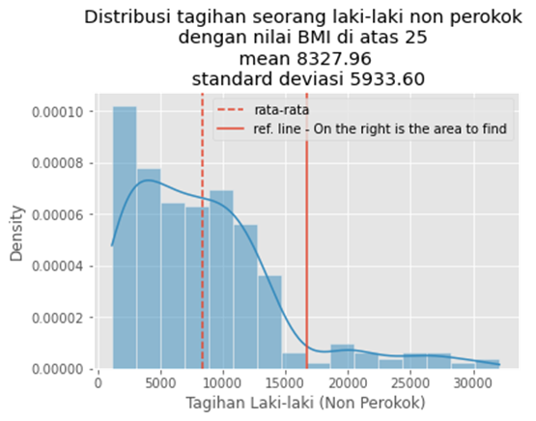
Female vs Male
Which one is more probable? Non-smokers male with a BMI above 25 will get high charges
First, look for the average value of the bill as well as find the standard deviation value.
The probability of non-smokers males with a BMI above 25 having high charges (16,700 USD) is 7.91%.

Slide 30
Analysis
First, look for the average value of the charges as well as find the standard deviation value. Then find the area under the curve using the mean and standard deviation. The probability value sought is to the right of the reference point (16,700 USD).
The probability of someone having high charges is 38.85%. The probability value will increase if someone with high charges has a BMI above the standard; the probability value is 41.5%. The probability value will decrease if someone with high charges has a BMI is less than 25; the probability value is 19.62%.

Slide 31
Analysis
What if we compared the probabilities of smoking users and non-smokers with an above-normal BMI? The probability of someone who smokes with a BMI above 25 having high charges is 95.77%. Meanwhile, The probability of someone who is a non-smoker with a BMI above 25 having high charges is 9.06%. It could happen because, from the beginning, the distribution of charges for smokers and non-smokers was different. The minimum price to be paid by a smoker alone has touched the figure of 12,800 USD. At the same time, the minimum price a non-smoker must pay is only 1,120 USD, so the standard of payment differs.
What if we now compare charges probabilities by gender with an above-standard BMI? The probability of non-smokers females with a BMI above 25 having high charges is 10.17%. Meanwhile, The probability of non-smokers males with a BMI above 25 having high charges is 7.91%. Females will likely get higher charges than males if their BMI values exceed 25. BMI does not affect gender, so BMI charts are the same for adult females and males.

Slide 32
Variables Correlation
Notes:
Transisi antar outline

Slide 33
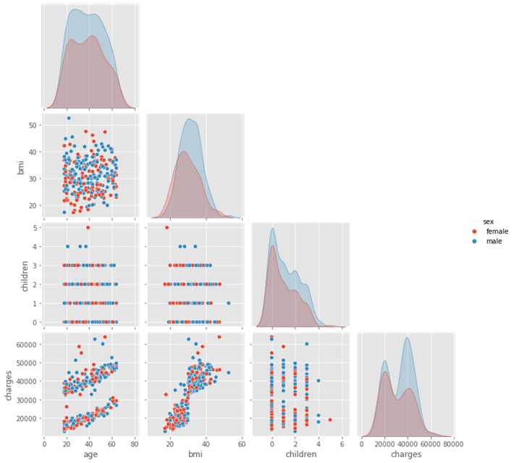
Pairplot - Smokers
The purpose of data plots using pairplot is to see what variables have strong or weak correlations. The data will filter with smoker data and non-smoker data. So the pairplot show as follows:
The above plot is a smoker data showing several possible variables that correlate, for example:
Age and Charges;
BMI and Charges;
Age and BMI.

Slide 34
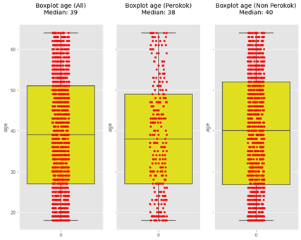
Boxplot - Age
Look at the spread of data from age and look for outliers.
There was no difference in the median value in the union, smokers, and non-smokers’ age data. There are no outliers in the three data.

Slide 35
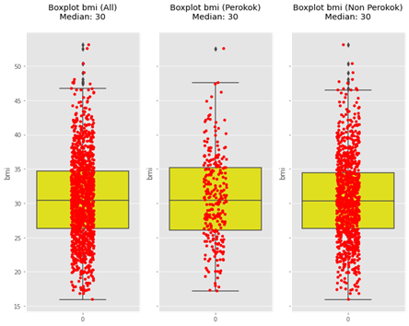
Boxplot - BMI
Look at the spread of data from BMI and look for outliers.
There was no difference in the median value in the union, smokers, and non-smokers’ BMI data. However, the union and non-smokers BMI data have many outliers.

Slide 36
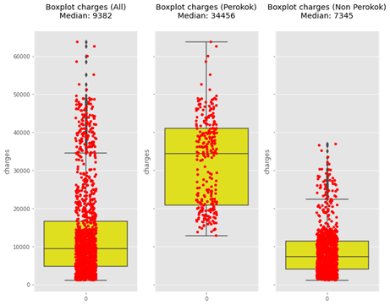
Boxplot - Charge
Look at the spread of data from BMI and look for outliers.
There was no difference in the median value in union and non-smokers charges data, but smoker’s charges data have a very high median value. However, the union and non-smokers charges data have many outliers.

Slide 37
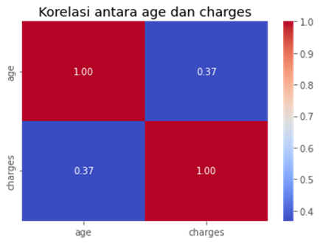
Correlation – Age and Charge (Smokers)
Find the correlation coefficient of a smoker's age and charge.
Age and charges have a weak positive correlation of 0.37.

Slide 38
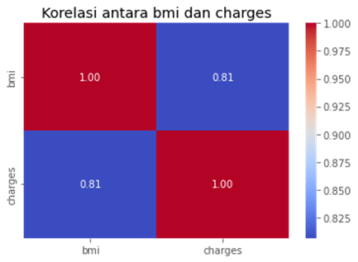
Correlation – BMI and Charge (Smokers)
Find the correlation coefficient of a smoker’s BMI and charge.
BMI and charges have a strong positive correlation of 0.81.

Slide 39
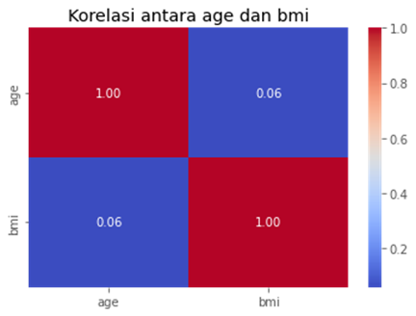
Correlation – Age and BMI (Smokers)
Find the correlation coefficient of a smoker’s BMI and charge.
Age and BMI do not correlate because the correlation value is close to zero.

Slide 40
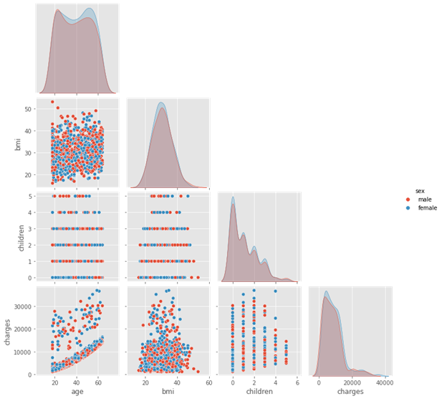
Pairplot – Non-Smokers
An explanation of what you did
The above plot is non-smoker data showing several possible variables that correlate. Any variables that correlate the same as the data smoker but are strong or weak in correlation will investigate further.

Slide 41
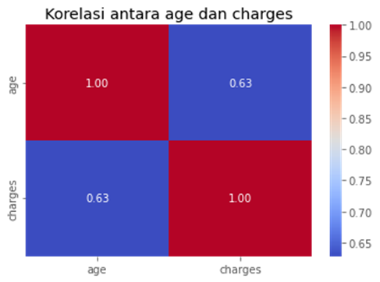
Correlation – Age and Charge (Non-smokers)
Find the correlation coefficient of non-smokers age and charge.
Age and charge have a strong positive correlation of 0.63.

Slide 42
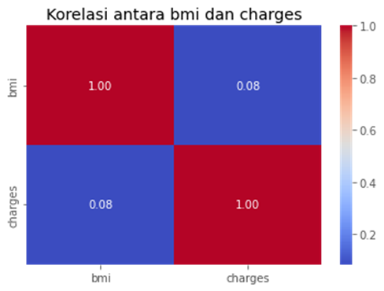
Correlation – BMI and charge (Non-smokers)
Find the correlation coefficient of non-smokers BMI and charge.
BMI and charges do not correlate because the correlation value is close to zero.

Slide 43
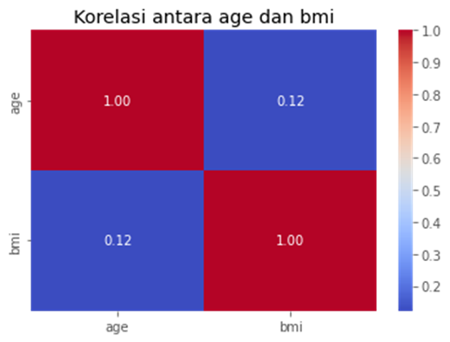
Correlation – Age and BMI (Non-smokers)
Find the correlation coefficient of non-smokers age and BMI.
Age and BMI have a weak positive correlation of 0.12.

Slide 44
Hypothesis Testing
Notes:
Transisi antar outline

Slide 45
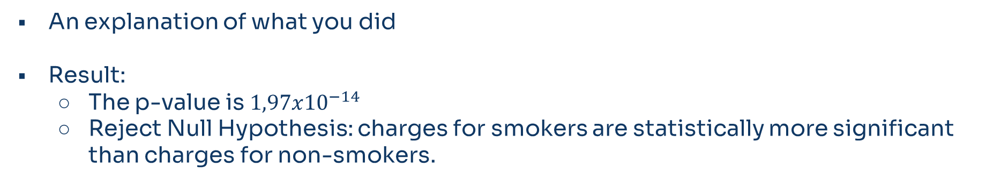
Smoker’s charges are higher than non smoker’s
An explanation of what you did
Result:
The p-value is $1,97x{10}^{−14}$
Reject Null Hypothesis: charges for smokers are statistically more significant than charges for non-smokers.

Slide 46
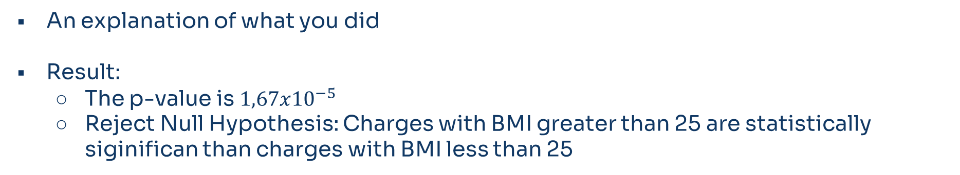
High BMI charges are higher than low BMI
An explanation of what you did
Result:
The p-value is $1,67x{10}^{−5}$
Reject Null Hypothesis: Charges with BMI greater than 25 are statistically siginifican than charges with BMI less than 25

Slide 47
Is female and male BMI the same
An explanation of what you did
Result
The p-value is 0.089
Fail to Reject Null Hypothesis: the BMI of females and the BMI of males are not statistically different

Slide 48
Conclusion
Notes:
Transisi antar outline

Slide 49
Conclusion
The average age of users in this dataset has an age range of 39-40 years. The overall average BMI was 30.6. The proportion between females and males balances during the charge distribution skew. So the median value is more reliable than the average.
However, if examined more closely, the proportion of users who smoke and do not smoke differs. The number who smoke is only about 20% of the entire dataset. Then the proportion of females and males changed. Their previously balanced proportion is now an increasing proportion of men. That is, the probability of males getting high health charges; probability value also increased to 58%. In comparison, the probability value of females fell to 42%.

Slide 50
Conclusion
What is the value limit if medical bills are declared high? So we set 16,700 USD as the limit value in this experiment. From all datasets, the probability of someone getting a high health bill is 38.85%. If we add one more condition, the BMI value is above the standard. Then the probability value increases to 41.5%, and vice versa; if the BMI value is below the norm, the probability value drops to 19.62%.
Suppose the condition adds one more, such as a user who smokes and does not smoke. So it is unnecessary to calculate the probability again because the distribution of health bills for smokers and non-smokers differs. The minimum charge for smokers is around 12,000 USD, while the maximum charge for the entire dataset is about 30,000 USD. Based on a predetermined limit, namely: 16,700 USD. So if someone is a smoker with a BMI value above 25, the chances of him getting a high health charge are huge.

Slide 51
Conclusion
Now, we will look for the probability value of a non-smoker user based on gender. Still, the BMI value is above the standard in the same conditions. The probability of high health charges by gender is not much different. However, the probability of females is slightly higher than that of males. The probability of a female with a BMI value above 25 is 10.17%.
After analyzing the correlation between smoking users, BMI and health charges had a strong positive correlation. Meanwhile, age and health charges have a weak positive correlation. Age and BMI do not correlate.
Then, a correlation analysis on non-smoking users found that age and health charges had a strong positive correlation. Meanwhile, age and BMI have a weak positive correlation. BMI and health charges are not correlated at all.

Slide 52
Conclusion
Next, do hypothesis testing for several assumptions. The test statistic used is the z-test with two variables. I was using the z-test because this dataset has more than 30.
The first hypothesis testing can conclude that charges for smokers are statistically more significant than charges for non-smokers. The p-value is 1,97x10^(-14).
The second hypothesis testing can conclude that charges with BMI greater than 25 are statistically significant than charges with BMI less than 25. The p-value is 1,67x10^(-5).
The third hypothesis testing can conclude that the BMI of females and the BMI of males are not statistically different. The p-value is 0.089.

Slide 53
Reference
list all of references you used

